Slide 2
Layer 2 Attacks
ARP Poisoning
MAC Cloning
MAC Flooding

Slide 3
Layer 2 and OSI Model
Application
Access to network resources
Presentation
Formatting to standard format
Session
Opening, closing, maintaining communication
Transport
Sequencing, segmentation, host-to-host communication
Network
Addressing and routing
Data Link
LAN communications, forwarding, media access
Physical
Electrical communications, media

Slide 4


ARP Process
Local Broadcast
Network
Who has 10.10.10.10?
10.10.10.10
ARP
Tell 10.10.10.10 is at 01-02-03-AA-BB-CC
Data Link
01-02-03-AA-BB-CC
ARP Cache
Notes:
Show ARP Table

Slide 5


Layer 2 Attacks – ARP Poisoning
Local Broadcast
Source computer
Who has 10.10.10.10?
10.10.10.10 is at attacker’s MAC
ARP Cache
Notes:
Show ARP Table
Show Wireshark with ping to bogus IP
Show the ARP process trying
Then show legit/complete process

Slide 6
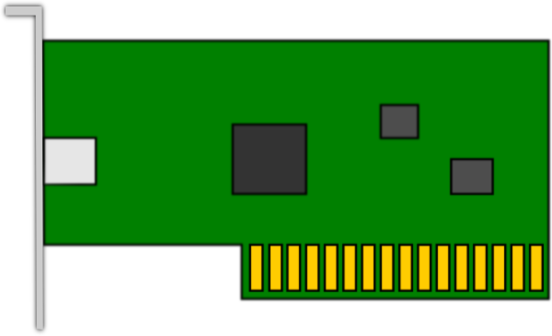
MAC Address Cloning
Computer A
Computer B
01-23-78-AB-CD-EF
00-A3-D2-CC-12-EE
Notes:
Show ARP cache
Show Wireshark with ping to bogus IP
Show the ARP process trying
Then show legit/complete process

Slide 7
MAC Address Cloning
Computer A
Computer B
01-23-78-AB-CD-EF
01-23-78-AB-CD-EF
00-A3-D2-CC-12-EE
macchanger
Notes:
Show ARP cache
Show Wireshark with ping to bogus IP
Show the ARP process trying
Then show legit/complete process

Slide 8
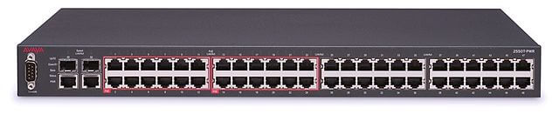
Layer 2 Attacks - MAC Flooding
MAC Address | Port #
01-00-03-AA-BB-CC | 10
02-03-04-DD-EE-FF | 22
11-22-33-AB-CD-EF | 43
-- | --
-- | --

Slide 9

MAC Flooding
MAC Address | Port #
01-00-03-AA-BB-CC | 10
02-03-04-DD-EE-FF | 22
11-22-33-AB-CD-EF | 43
00-11-33-DE-F3-E2 | 05
00-12-33-00-12-AE | 13
00-11-33…
00-12-33…
01-12-33…
01-12-33…
Notes:
Show MAC address

Slide 10

MAC Flooding
Fail-open
Flood all ports with broadcast traffic
Sniffing
Store/use all data

